Slide 1
Practical Project: Movie Review Application

Slide 2
Introduction
Who am I?
QA IT Consultant Trainee, I have learnt how to use Java, MySQL and Maven by using the tools I needed to complete my projects.I have come across multiple issues during the project, but I finally found a formula that helped me approach coding with a more confident attitude.
How did I approach specification?
Firstly, I wanted to understand the technologies and tools needed to used to complete the project and cultivate my time management. I will also create my ERDs (entity relationship diagram) and UML diagrams (unified modelling language) to have some structure when building my classes. In addition I also created a Jira project to follow my plan through a ‘sprint’. the domain specs into user stories as my aim was to integrate them into the project to link each branch and commit to a user story.

Slide 3
Concept
How did I initially approach the problem?
I created a roadmap on jira to show my journey and if there may be any changes needed to do, I can quickly go into my project management board and manipulate it.The project was easier to start as I had all my steps and assigned each step to a sprint. I was able to have a starting point of the backend development, then testing, then front end.

Slide 4
Sprint Plan
What needed to be included? What did I hope to achieve?
The project must have a HTML/CSS/JS front-end developed that presents the user with movies and their reviews that they can interact with. Also implements CRUD functionality
Implemented a codebase which linked from frontend to backend and is functional.

Slide 5
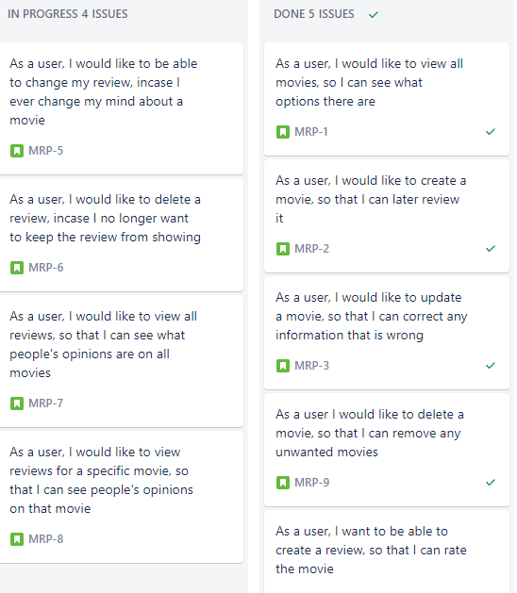
Project Roadmap

Slide 6
Consultant Journey
What technologies have you learned for the project?
Git,GitHub,MySQL,Jira,Srinng,Java,HTML,CSS,JavaScript,Maven,Mockito and Junit.

Slide 7
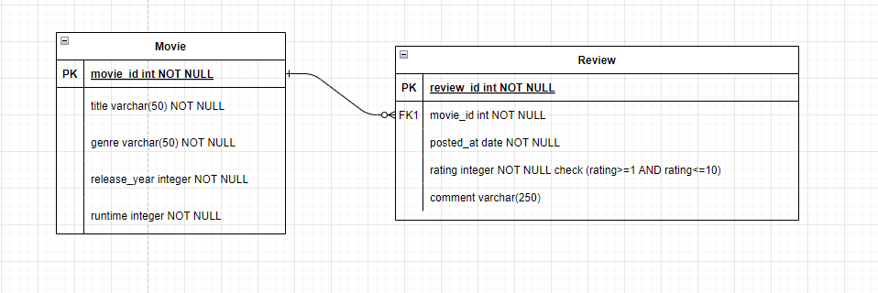
ERD

Slide 8
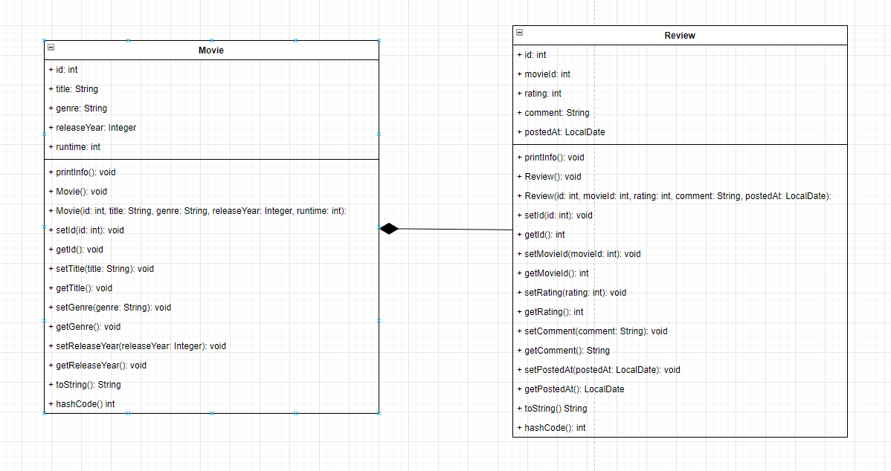
UML

Slide 9
Risk Assessment
Description | Evaluation | Likelihood | Impact Level | Risk | Responsibility | Response | Control Measures
leaked information | Including SQL Information with product | Low | Low | 4D | Developer | Create an example clone of the app properties file with password added. | SQL server is hosted and accessed locally with no route through the router.
No meeting deadline | Handing in unfinished project | Medium | Critical | 3A | Developer | create a working version. | Use Jira to plan out the steps im on each sprint and avoid hang ups
Accidently confusing working branches | Not switching to appropriate branches | Medium | High | 3B | Developer | Use revert to undo specific commits | Ensure through Git that the correct branch is being worked on
Not including the correct dependencies | tool will not function | Medium | Low | 3D | Developer | Investigate if any dependencies are needed to run certain tools | Only add in tools from which the dependencies are known
Losing internet connection while remotely operating | Unable to submit/pus h to Git, Unable to update Jira | Low | High | 4B | ISP | Switch to Mobile Data for important updates | Do not change any settings/router configurations while working on a project to ensure that stability is the best it can be on my end. However an area outage is out of m
Chance of Dropping a Table during testing | Confusing test files with main | Low | Medium | 4C | Developer | Recreate Table entries | Back up any Entries added in a document to be included in documentation

Slide 10
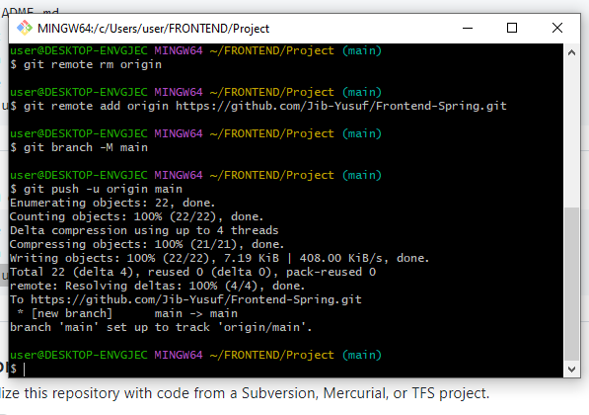
Continuous Integration
How did I approach Version Control?
GitHub–I managed to maintain continuous commits to update my modifications consistently. Furthermore I also made sure that the new updates were on feature branches so that it does not main the source code of the whole programme. I then branched off the dev and incorporated the feature branches which I then late merged to the dev. Finally once dev has working source code that is not broken, I merged it into the main branch.

Slide 11
Testing
What was tested?
I tested all my JAVA source code
In this project I had to get 80%,I managed to get 60% testing my movie .i came across multiple error I could not seem to resolve. This hinders me from achieving 80% before the presentation.

Slide 12
Sprint review
What did I complete?
I did not manage to achieve all the user stories I aimed to complete it within the sprint. I also have all CRUD functionality working for both movie and review entities in postman.
What got left behind?
I completed the CRUD for movie in the front-end web development. I did not create the CRUD functionality for reviews in the front-end in time, although it is still functional in the back-end. I did not achieve the acquired 80% test coverage

Slide 13
Sprint Retrospective
What went well?
Constructing the entity classes was simple to create whilst identifying their relationship (i.e. one to many). Service classes were also easy to make. I managed to get full CRUD functionality in the back-end to work.
What could be improved?
Possibly create a better plan in the future. I did not have enough time to complete the front-end as I lost too much time developing the back-end as I needed to priorities which part is more important, and testing the backend code. I ran into a lot of unknown errors in testing which I had to try overcome by doing a lot of research.

Slide 14
Conclusion
Reflections on the project, future steps, any other relevant info
my core reflections is definitely time management for the project. To make sure I plan my time accordingly with some leeway to prepare for bug fixes throughout my project.
I done well as to how I managed my version control, through creating feature branches and later merging them into the develop branch.
Also taking breaks accordingly when working. At the end of the week, I felt mentally exhausted as I spent the whole week on my monitor, not taking as many breaks as I probably should have. I noticed when I did take the breaks, it cleared my mind a bit more and helped me identify issues quicker at times.
Finally, I need to improve and keep upskilling and to try understand the code more, allowing me to create cleaner code and increase work efficiency.

